Slide 1
(a) t=0s
(b) t=121s
(c) t=107 s
(d) t=300 s

Slide 2
(e) t=25 s
(f) t=300 s
(g) t=37 s
(h) t=300 s
Fig. 1. Snapshots of the simulation results.

Slide 3
Fig. 2. The HGSSA to plan evacuation path.

Slide 4
Fig. 3(a). Fig. 3(b). Fig. 3(c).
Fig. 3 Characteristics of quadrilateral grids.

Slide 5
(a)
(b)
Fig. 4. Evacuation routes in case of fire spread.

Slide 6
(a)t=0s (b)t=42s

Slide 7
(c) t=70s (d)t=98s
Fig. 5. Traditional SSA for evacuation route planning.

Slide 8
(a)t=0s (b)t=42s

Slide 9
(c)t=70s (d)t=98s
Fig. 6. The evacuation route calculated by the HGSSA.

Slide 10
(a)t=0s
(b)t=42s

Slide 11
(c)t=70s
(d)t=98s
Fig. 7. Evacuation path of IACO.

Slide 12
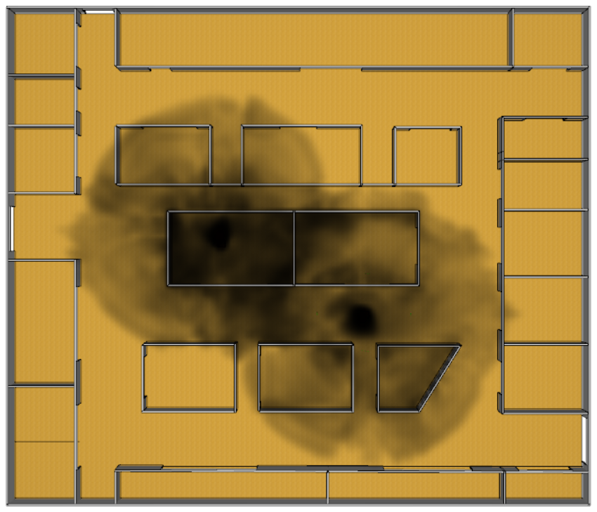
(a) Snapshots of the smoke(t=64s) (b) Snapshots of the CO concentration (t=64s)
(c) Snapshots of the visibility(t=43s) (d) Snapshots of the temperature (t=112s)

Slide 13
(e) HGSSA. (f) IACO.
Fig. 8. The offshoe platform multi-source fire simulation results.

Slide 14
Fig. 9. Framework for evacuation systems

Slide 15
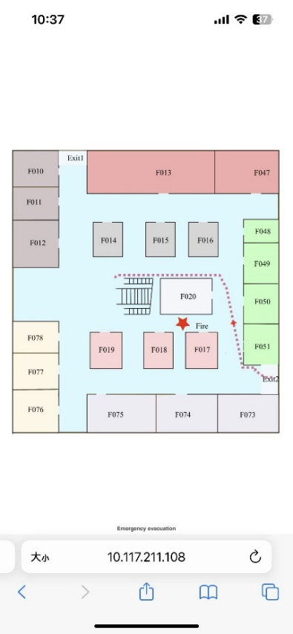
Fig. 10. Mobile display interface

Slide 16
Fig. 11. Flow rate of evacuees at exits

Slide 17
Fig. 12. Evacuation results of different proportions of evacuees using smart navigation application

